Slide 1
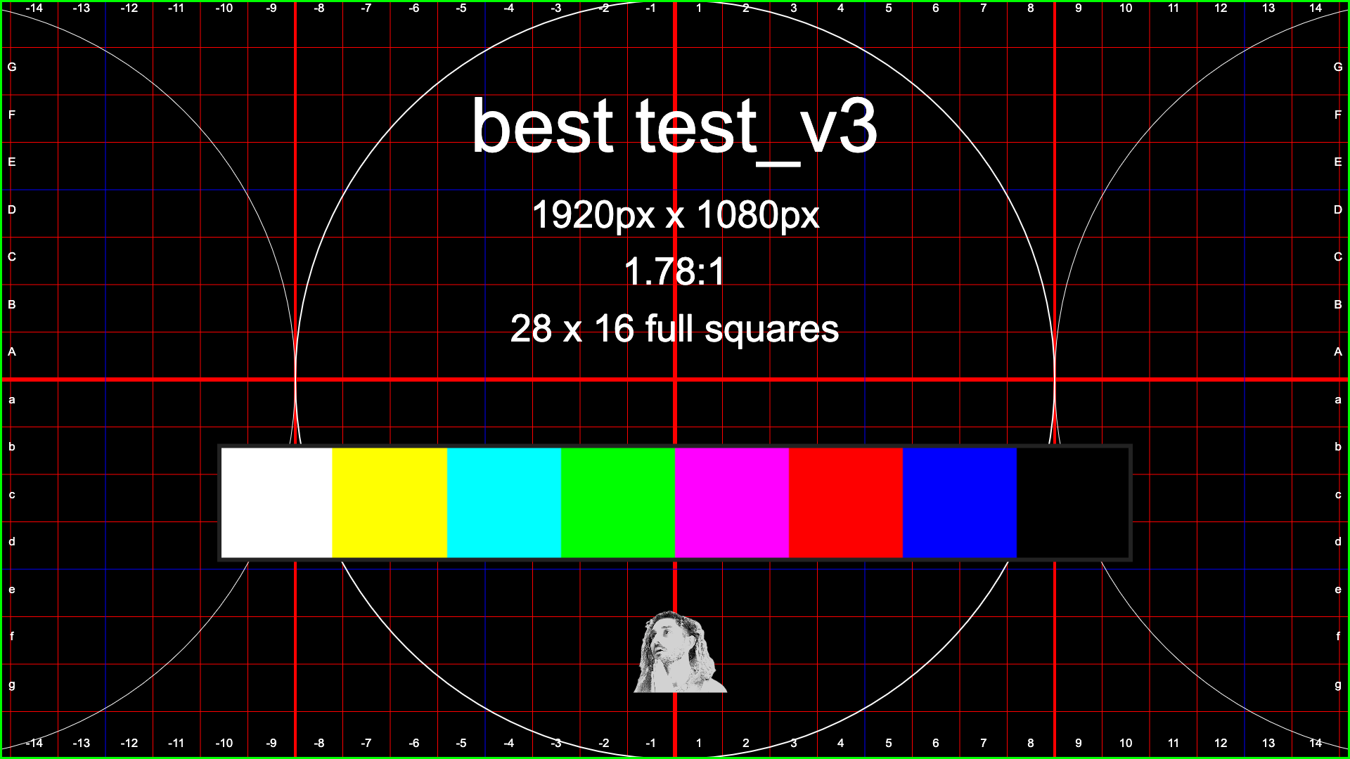
Notes:
Kia ora ☺
Welcome to best test, the PowerPoint that tests the best.
Created by Josiah Liston with input from Dean Holdaway, Reuben Eruera, Mike Oppenheim, Shaun Phillips, reddit users @vjhoming and @_Mr_That_Guy_
This is Version 3, finalized on April 9th, 2025.
There are notes on every slide of this presentation that detail the technical purpose of each slide.
This functions as a technical guide for seasoned techs, training for fresh techs, and to test presenter notes for vision foldbacks.
This first slide is from www.viosio.com ’s test pattern generator.
It features the resolution of this powerpoint(1920x1080), a green border a few pixels thick to show if you’re cutting edges off the image, text on the outer edges to assist with focus, gridlines and big circles to show image warping, and a mini colour bar to show if you’re receiving all your colours.
The final “feature” is a very non-technical small image of the author, Josiah.
I originally put this in here as a joke, but it helps me see if the aspect ratio is off, so I left it in.
Any suggestions for changes, updates, new images or better images for this presentation are VERY appreciated.
You can contact me @josiahliston on insta or @lookandliston on reddit
If you find this useful and can afford it, please consider supporting at https://ko-fi.com/josiahliston

Slide 2
PPT 1
Notes:
This is an image for testing that multiple machines in a setup are patched correctly.
Display this image on your PPT 1 machine, and simultaneously display the next slides (PPT 2-6) on any other ones.
This will let you see that each laptop is being received in the correct inputs on your switcher.
Each of these slides has a different colour as a visual aid, and each has a green border to show if the image is being cropped.
(The text is editable so you can relabel them for your use case. “PPT Main”, “PPT Backup”, “Countdown”., “Notes”, “Video playback”, etc.)

Slide 3
PPT 2
Notes:
See “PPT 1” slide for details

Slide 4
PPT 3
Notes:
See “PPT 1” slide for details

Slide 5
PPT 4
Notes:
See “PPT 1” slide for details

Slide 6
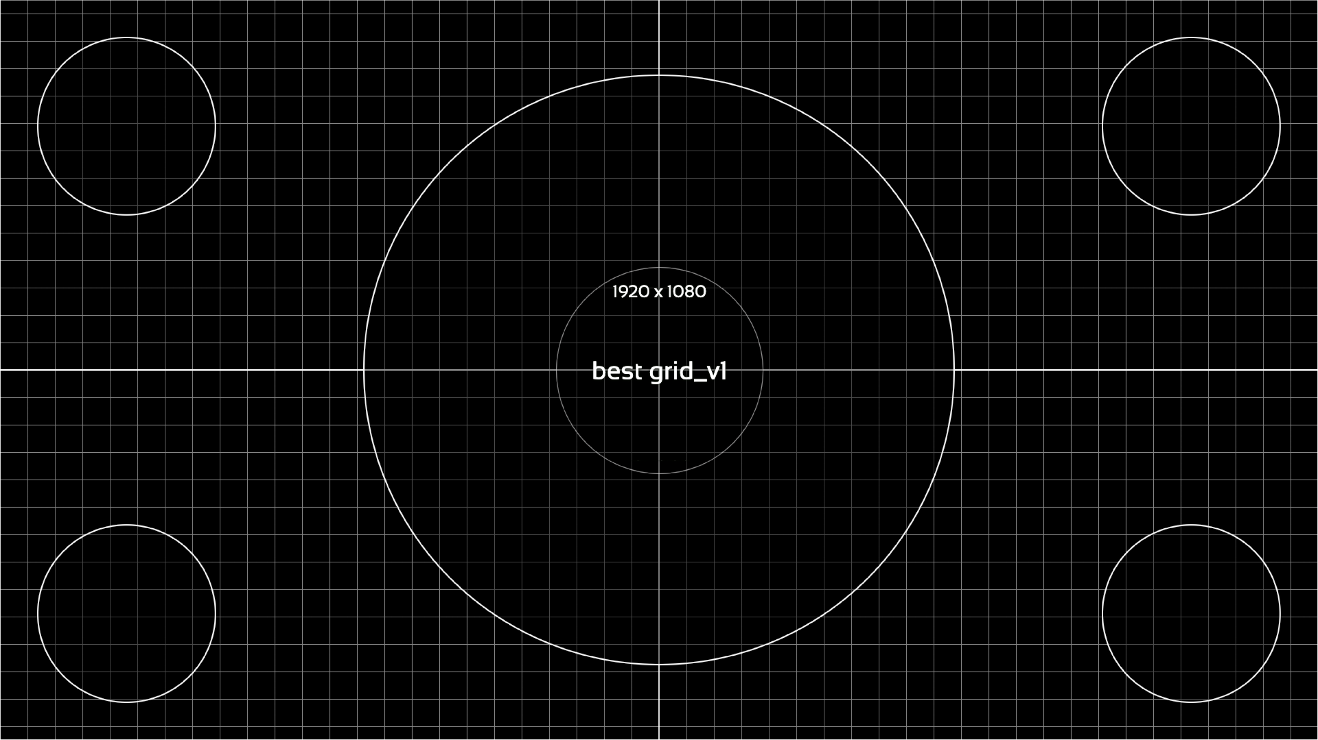
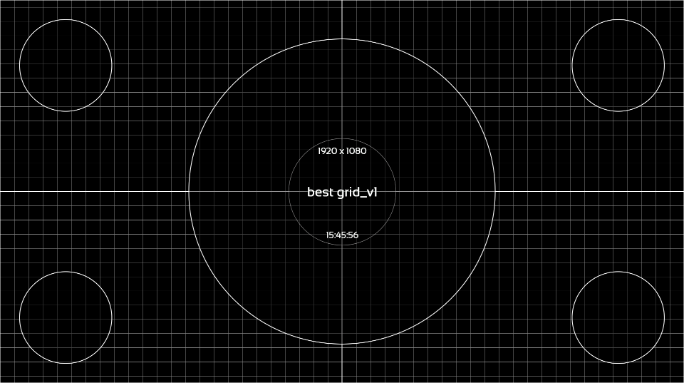
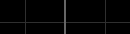
Notes:
This is a 1920 x 1080 grid.
Each of the vertical/horizontal gridlines is a single pixel thick. These help show warping on your projection surface.
There is a single pixel white border on this image. For various reasons, this often gets cut off on one or more sides. This stresses technicians out…but for a powerpoint presentation, in most scenarios, this isn’t a big deal.
If you can see the green border all the way around on the previous slide, you’ll be fine.
The circles in the middle and corner show any issues with warping, which is especially useful when projecting.
If they look like proper circles, you’re doing great.
The lines can also help show how focus shifts around your image. If some parts of your image are in focus and others aren’t, you can use this slide to help diagnose why.
Test image stolen from Kards, an incredible test pattern generation software by Alteka.

Slide 7
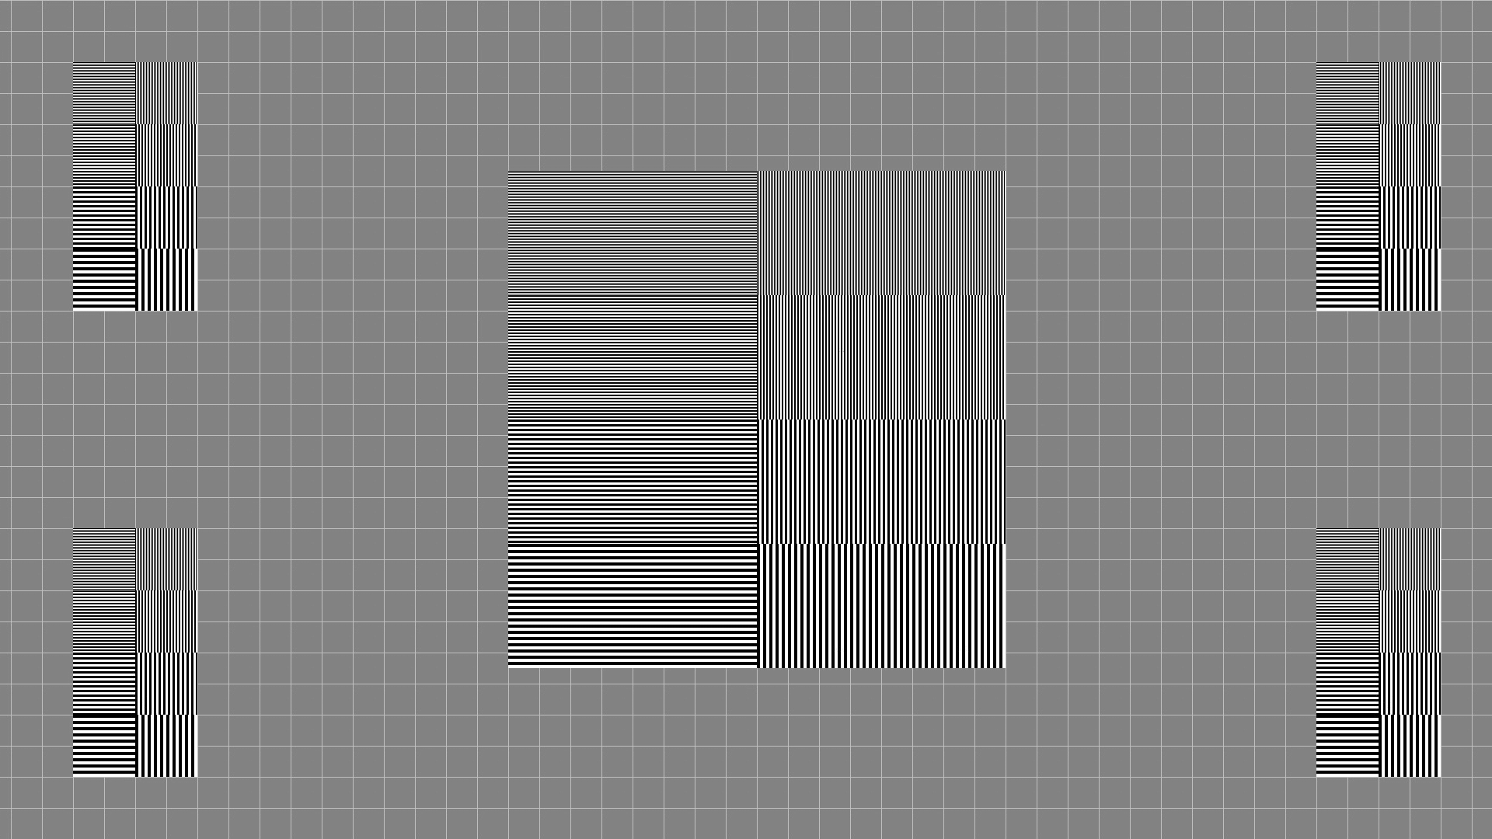
Notes:
This is an image compression test.
Each rectangle features 4 rows of progressively wider black and white lines.
Each set of horizontal and vertical lines should look like a trippy, but technically perfect, set of white and black lines.
If your image is compressed, these can band together into sets of darker and brighter “waves”, this is caused by compression smooshing multiple lines into all black or white lines.
If it’s really compressed, it’ll turn the smallest lines into grey noise (it often looks like this in the PPT preview)
To see an exaggerated version of what I mean, resize the powerpoint window really small and watch how the lines transform as the image is compressed into a smaller size on your screen.

Slide 8

1080p50fps
1080p50fps
Notes:
This 1080p, 50fps horizontal radar test pattern should look smooth as butter on a 50hz system.
The gradient and line move at exactly 1 pixel per second. At 25 frames, that’s 2 pixels per second.
If it’s jumpy:
Check your computer, switcher, converters etc. are all running at 50p/hz
Check your computer’s graphics settings are set to it’s highest modes. If it’s a Windows laptop it may need it’s charger plugged in for smooth playback.
If the image is being scaled to a different resolution, it will usually look jumpy.
This is a stress test to help show and diagnose issues. Some minor jumpiness often looks fine during simple video playback.
This test pattern was created by Dean Holdaway.

Slide 9

1080p50fps
1080p50fps
1080p50fps
Notes:
This 1080p, 50fps vertical radar test pattern should look smooth as butter on a 50hz system.
The gradient and line move at exactly 1 pixel per second. At 25 frames, that’s 2 pixels per second.
If it’s jumpy:
Check your computer, switcher, converters etc. are all running at 50p/hz
Check your computer’s graphics settings are set to it’s highest modes. If it’s a Windows laptop it may need it’s charger plugged in for smooth playback.
If the image is being scaled to a different resolution, it will usually look jumpy.
This is a stress test to help show and diagnose issues. Some minor jumpiness often looks fine during simple video playback.
This test pattern was created by Dean Holdaway.

Slide 10
1080p60fps
1080p60fps
Notes:
This 1080p, 60fps horizontal radar test pattern should look smooth as butter on a 60hz system.
The gradient and line move at exactly 1 pixel per second. At 30 frames, that’s 2 pixels per second.
If it’s jumpy:
Check your computer, switcher, converters etc. are all running at 60p/hz
Check your computer’s graphics settings are set to it’s highest modes. If it’s a Windows laptop it may need it’s charger plugged in for smooth playback.
If the image is being scaled to a different resolution, it will usually look jumpy.
This is a stress test to help show and diagnose issues. Some minor jumpiness often looks fine during simple video playback.
This test pattern was created by Dean Holdaway.

Slide 11
1080p60fps
1080p60fps
Notes:
This 1080p, 60fps horizontal radar test pattern should look smooth as butter on a 60hz system.
The gradient and line move at exactly 1 pixel per second. At 30 frames, that’s 2 pixels per second.
If it’s jumpy:
Check your computer, switcher, converters etc. are all running at 60p/hz
Check your computer’s graphics settings are set to it’s highest modes. If it’s a Windows laptop it may need it’s charger plugged in for smooth playback.
If the image is being scaled to a different resolution, it will usually look jumpy.
This is a stress test to help show and diagnose issues. Some minor jumpiness often looks fine during simple video playback.
This test pattern was created by Dean Holdaway.

Slide 12

Audio Test
A song is playing on an endless loop
Artist: Fat Freddy’s Drop
Song: Novak
Notes:
This slide automatically plays the credited song.
It’s professionally mixed and mastered at line level, so it should be a good reference point for volume and sound quality.
It’s also a nice sludgy bop from New Zealand’s own Fat Freddy’s Drop.

Slide 13
Left/Right Test
Test audio is playing on an endless loop
Notes:
This slide automatically plays an audio track that tests your Left/Right.
The words “Left Channel” should only be in the Left Channel.
The word’s “Right Channel”…you get it.
Left and right have been measured to be basically the same volume (within 1.5db of each other, it’s dynamic audio. Use the 1k test tone later in this PPT if you want it to be totally perfect)
It’s mastered to about -17 LUFS of loudness.
Featuring the voice of best test’s creator, Josiah Liston ☺

Slide 14
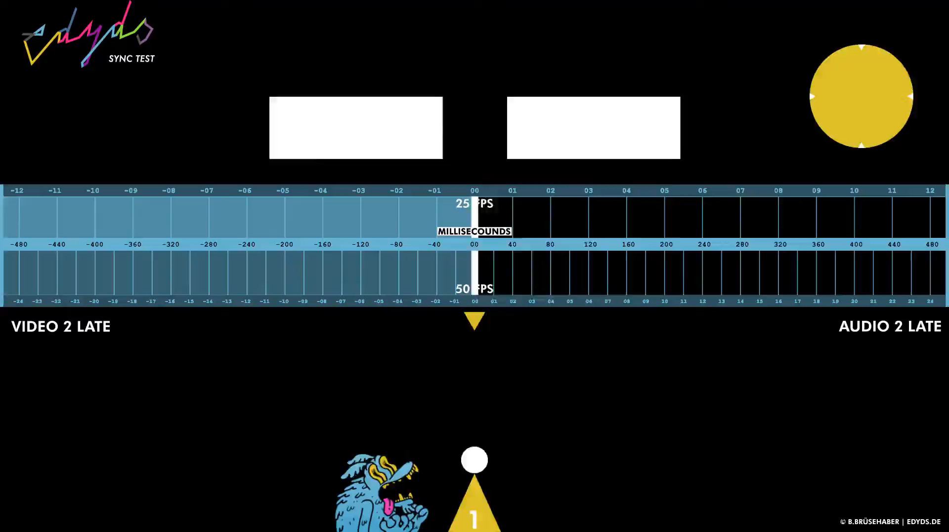
Notes:
This 50fps sync test is stolen from Edyds and I love it
It features a solid sample choice and multiple useful and different references for when the next noise hits.
It also features a S-tier millisecond counter that allows it to double as a 25/50fps test.
It also shows the exact milliseconds per frame.
When I’m syncing, I’ll often do a test record, pull it into Davinci Resolve, see how many frames out it is, and adjust the delay by the corresponding milliseconds.
Cheat sheet:
25fps – 40ms audio delay per frame
50fps – 20ms audio delay per frame

Slide 15
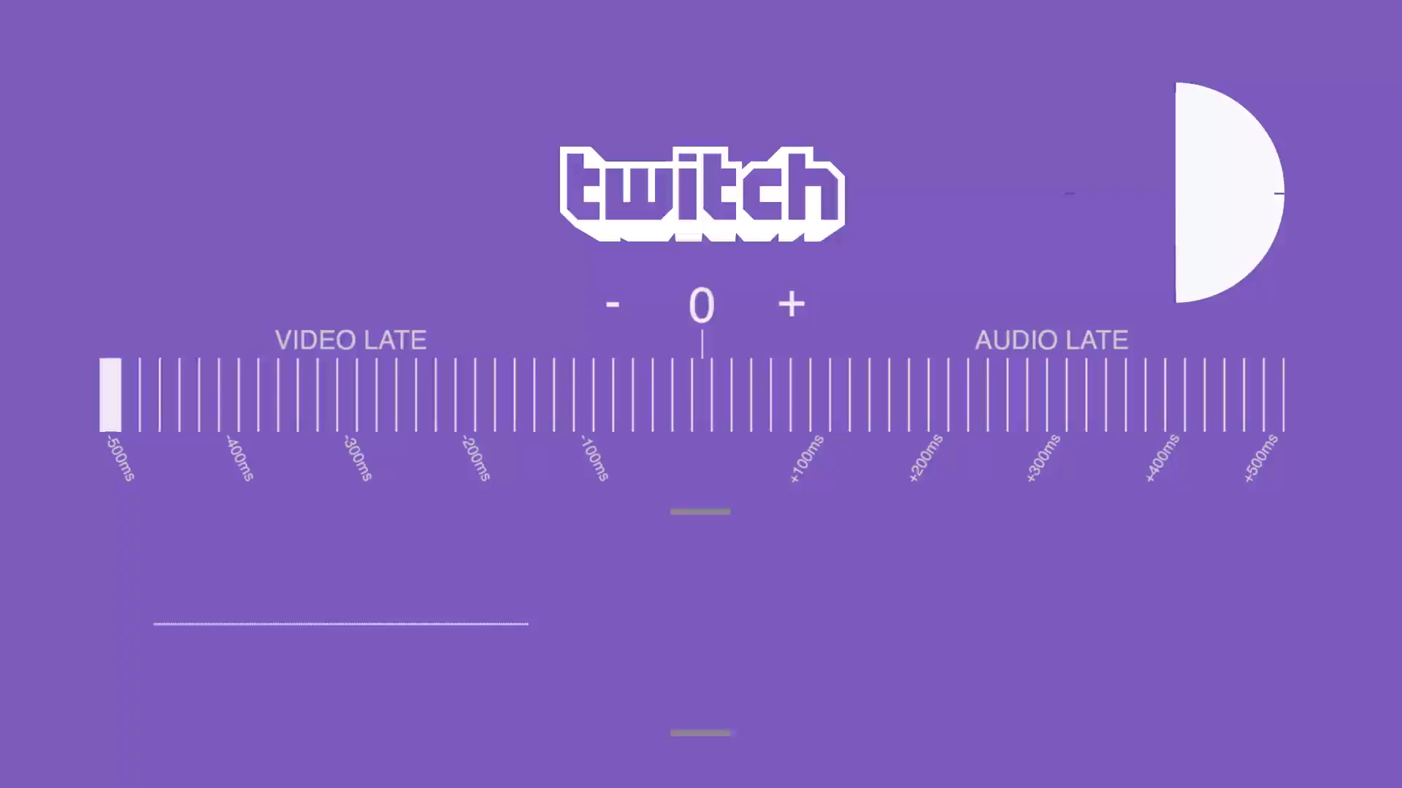
1920 x 1080
60fps
Notes:
The classic Twitch 60fps sync test.
It features a solid sample choice and multiple useful and different references for when the next noise hits.
It can be used for a 30 fps test as well, it’ll just cut half the frames.
It also shows the exact milliseconds per frame.
When I’m syncing, I’ll often do a test record, pull it into Davinci Resolve, see how many frames out it is, and adjust the delay by the corresponding milliseconds.
Cheat sheet:
30fps – 33.33ms audio delay per frame
60fps – 16.66ms audio delay per frame

Slide 16
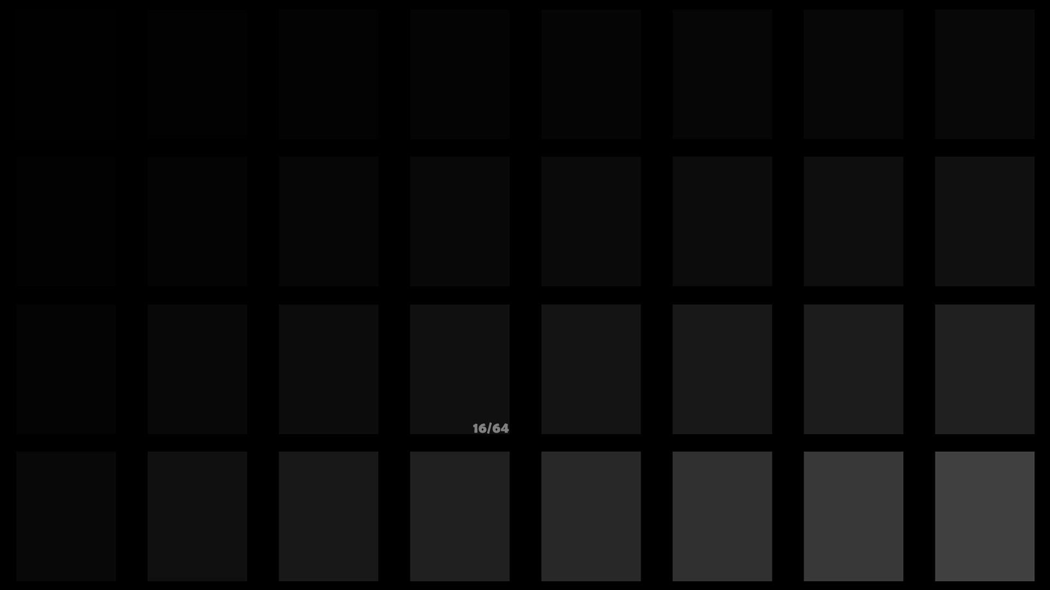
Notes:
This is a test pattern for setting black level (Brightness control) of a display.
It’s also useful with projectors to see how light bleed on your projection surface is affecting the darker parts of your images.
It’s best to get your gamma / contrast / brightness levels set before adjusting colour settings, as these brightness settings change the way colour is represented quite a lot.

Slide 17
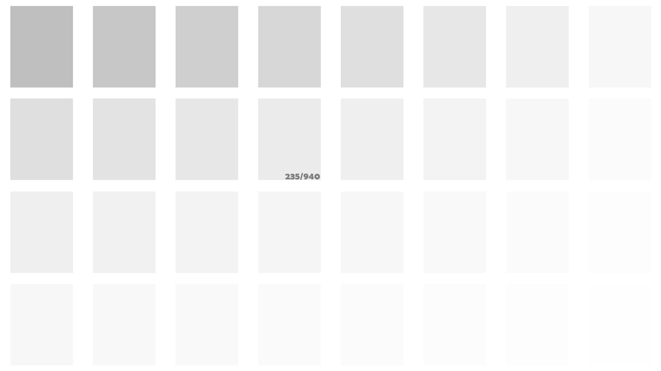
Notes:
This is a test pattern for setting white level (Contrast control) of a display.
It’s also useful with projectors to see how light bleed on your projection surface is affecting the darker parts of your images.
It’s best to get your gamma / contrast / brightness levels set before adjusting colour settings, as these brightness settings change the way colour is represented quite a lot.

Slide 18
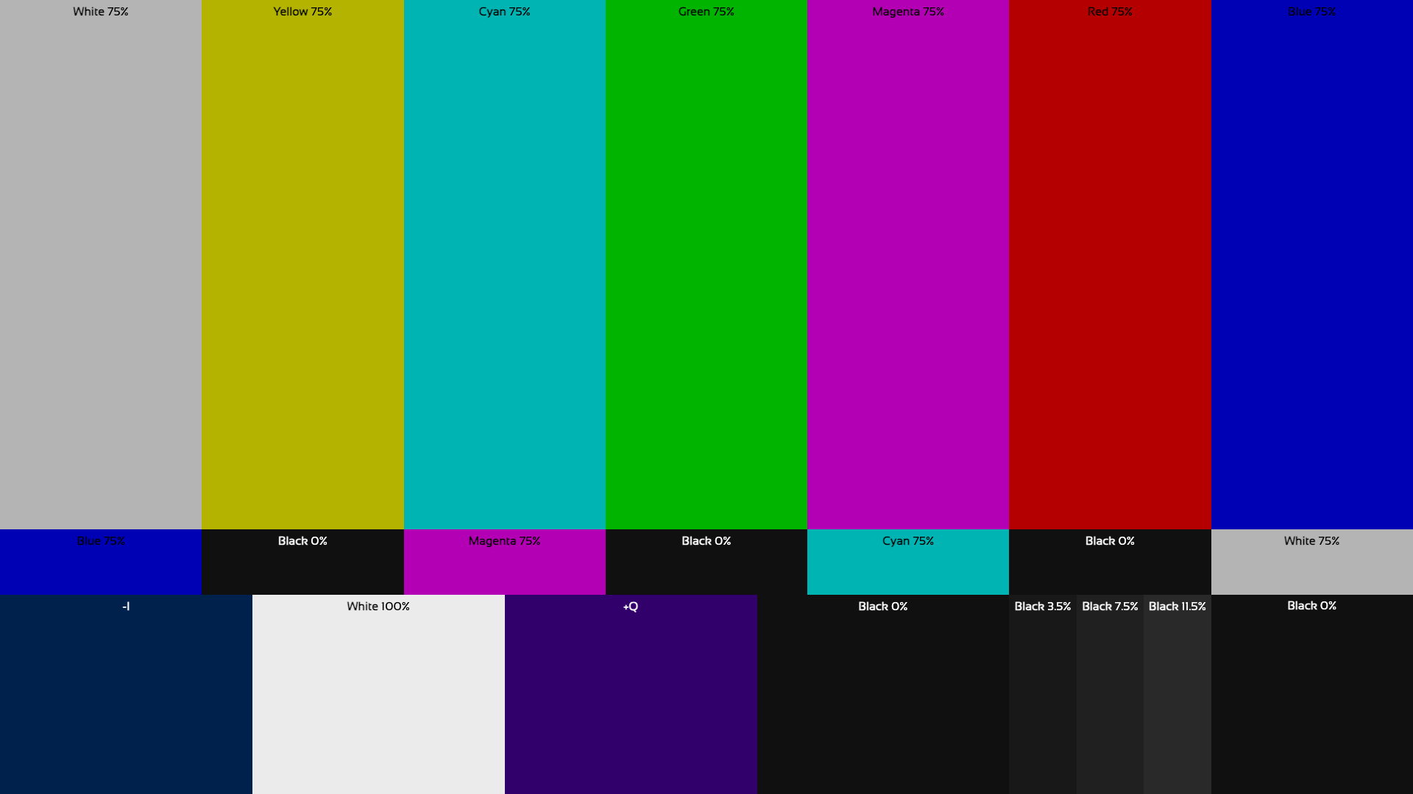
Notes:
These are colour bars, a great place to start with colour matching displays and projectors.
Each rectangle’s colour and brightness value is signified in it.
You’ll notice none of the colours are at 100%, so they should look a little dim compared to the 100% white rectangle.
Test image stolen from Kards, an incredible test pattern generation software by Alteka.

Slide 19
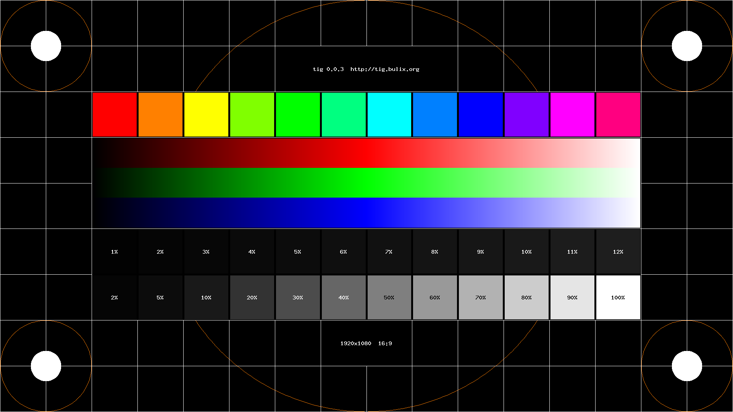
Notes:
This is a test pattern for colour correcting and seeing gamma/contrast issues.
Each of the top square’s colour values is at 100%, so they should be bright and punchy.
Each colorful square’s values are also perfectly halfway between the ones on it’s left and right.

Slide 20
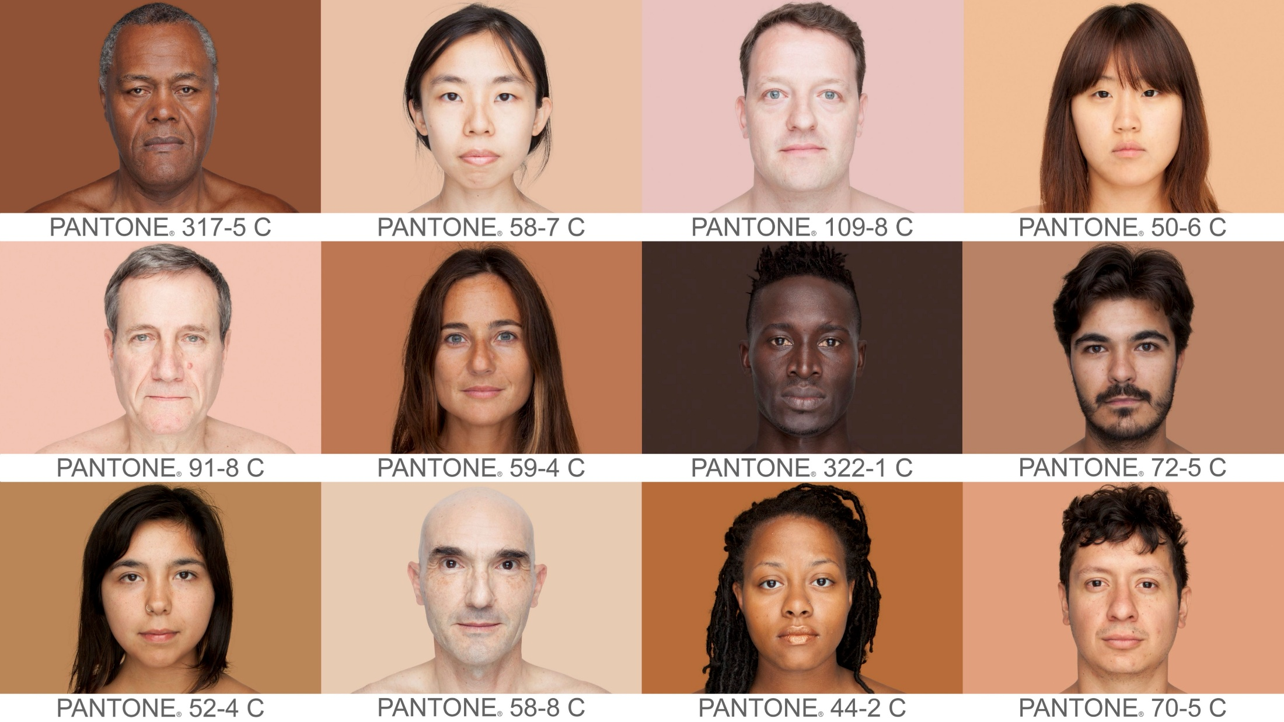
Notes:
This image is for adjusting a display/projector’s colour settings to work for various skin tones.
This is especially useful for anything that will be showing iMag or content with people in it.
While this image is tonally accurate for most image/video content, colour corrected iMag feeds will likely be less saturated.
Each person in this image is imposed over a pantone colour that matches an average value taken from an 11x11 pixel grid on their nose.
I collaged these images together, but the source for them is the Humanae project by Angélica Dass. (totally worth checking out)

Slide 21

Notes:
This image is also for adjusting a display/projector’s colour settings to work for various skin tones.
It’s nice for really fine tuning your skin tones and mid tones.
The saturation in this image should be similar to what you can expect from a colour balanced iMag feed, making it very useful for knowing how different skin tones may appear on screen.
This is a royalty free image I got from www.pexels.com

Slide 22
PPT 5
Notes:
See “PPT 1” slide for details

Slide 23
PPT 6
Notes:
See “PPT 1” slide for details

Slide 24

Notes:
This is the standard SMPTE colour bars with a 1k test tone at 0db, line level.
Typically used for broadcast applications. I’ve included it at the end of this presentation because sometimes people ask for SMPTE with 1k.
The 1k test tone can also be used to ensure your left and right audio channels are being received at the exact same volume.

Slide 25
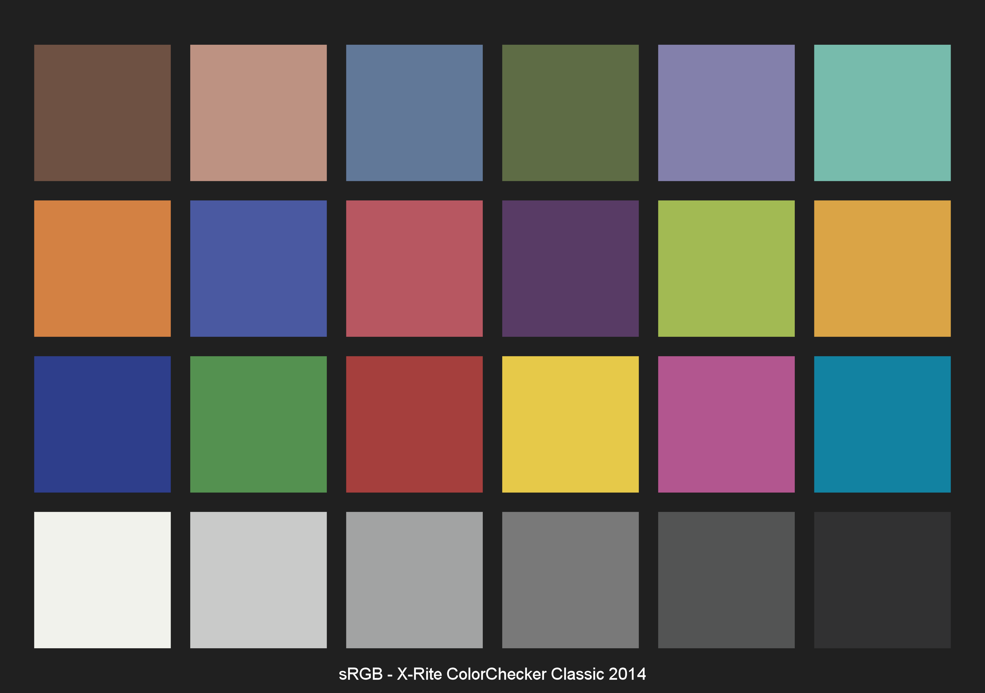
Notes:
This is the official sRGB/rec709 image of the Macbeth colour picker.
When I say official, I mean downloaded directly from X-Rite’s website.
This image is used for advanced colour matching. A rare application, so I included it at the end.
The process for this is buying an official Macbeth colour picker from X-Rite, placing it on your stage/set, putting this image on whatever screens are onset, and adjusting the camera/lighting/display settings so they look identical.

Slide 26
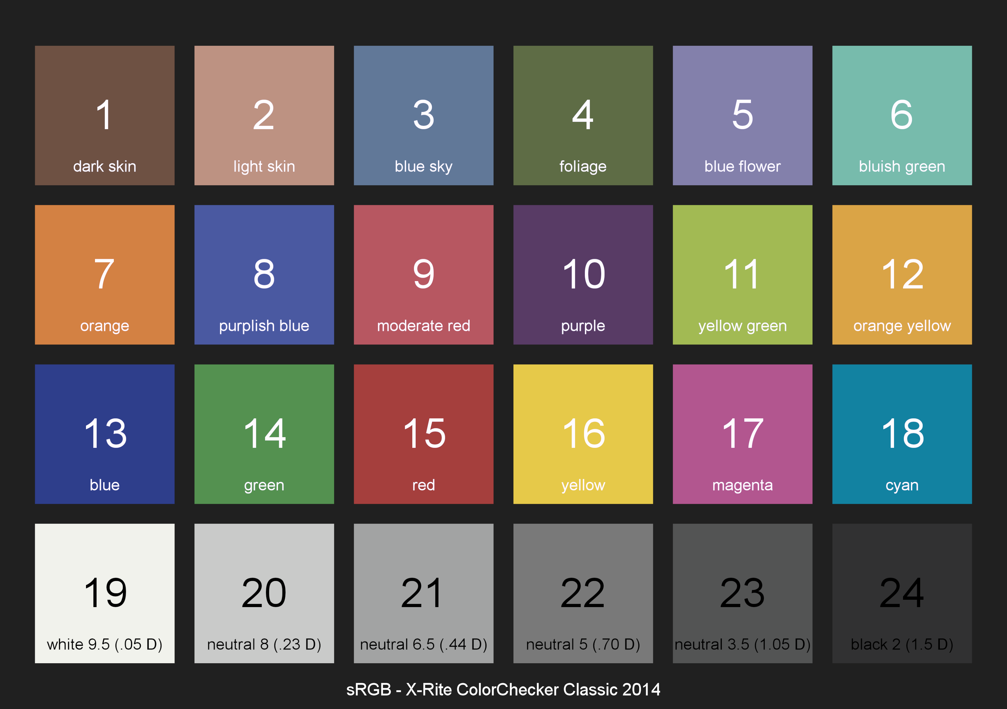
Notes:
This is the same as the last slide, but with the colour information.
And that’s it!!
Any suggestions for changes, updates, new images or better images for this presentation are VERY appreciated.
You can contact me @josiahliston on insta or @lookandliston on reddit
If you find this useful and can afford it, please consider supporting at https://ko-fi.com/josiahliston
(I highly appreciate suggestions)
Happy teching ☺

